Slide 1

70 East Lake Street Suite 1700 Chicago, IL 60601 www.ctbaonline.org
Gentrification in the City of Chicago
September, 2020

Slide 2
NHS clients’ characteristics
Median annual income of $61,980
$200,000 as the assumed typical home value
$2,000 in annual property taxes for a typical NHS client (1% of home value and less than 4% of annual income )
Legislation

Slide 3
Longtime Homeowner exemptions Requirements

Slide 4
NB map

Slide 5
Tract and NB (map)

Slide 6
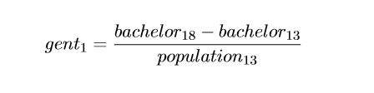
Gentrification definition #1
In order to be considered a “gentriﬁable” tract, household income must be below the median in 2013 ($58,676).
Definition 1: we use Tracts that experienced large positive changes (75th and 90th percentiles) in population aged+25 with a Bachelor Degree or Higher

Slide 7
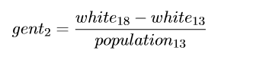
Gentrification definition #2
Definition 2: we use Tracts that experienced large positive changes (75th and 90th percentiles) in white population, excluding Latinos

Slide 8
Visual representation of percentile 75th and 90th

Slide 9
MAP of median income by tract (level)

Slide 10
MAP of median home value by tract (level)

Slide 11
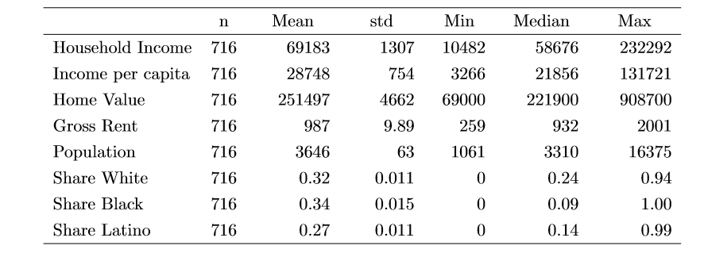
Income, Housing and Population in the City of Chicago by Tracts in 2013
Census data by Tract for the City of Chicago in 2013

Slide 12
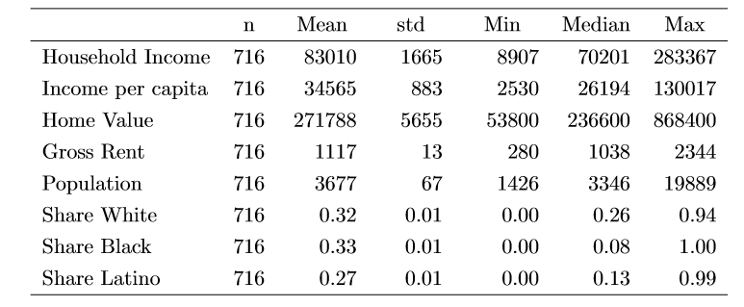
Income, Housing and Population in the City of Chicago by Tracts in 2018
Census data by Tract for the City of Chicago in 2018

Slide 13
MAP of tracts under gentrification def 1 for 75th and 90th percentile (use colors)

Slide 14
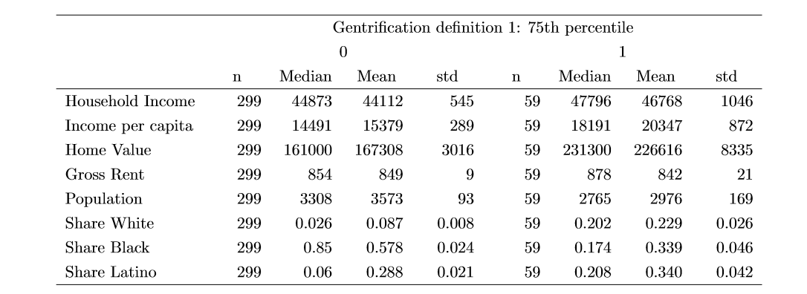
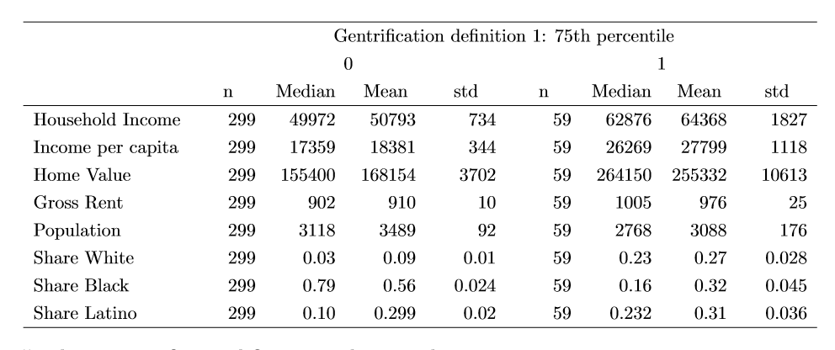
Summary Statistics – Def. #1 (75th per) clarify year next to table
Comments:
59 tracts meet definition #1. Gentrified tracts are initially less populated, with higher share of latinos, higher income and home values but median and mean rents are similar.

Slide 15
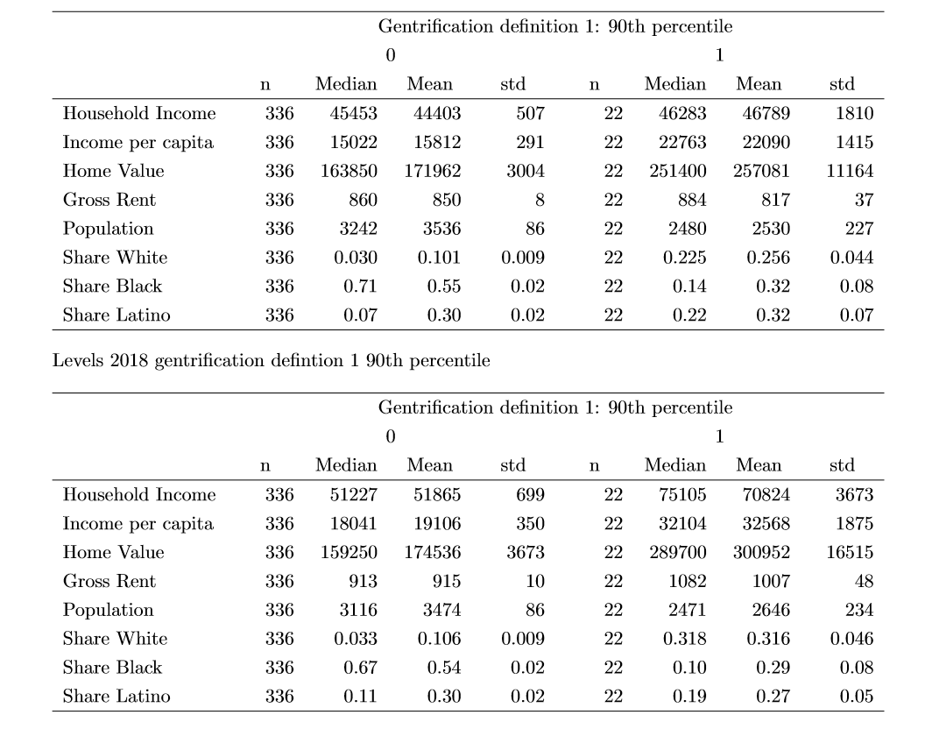
Summary Statistics – Def. #1 (90th per)
Comments:
22 tracts meet definition #1 with higher changes. Gentrified tracts have similar gross rent, they are less populated and have a high share of latino population and a low black or African American population.

Slide 16
MAP of tracts under gentrification def 2 for 75th and 90th percentile (use colors)

Slide 17

Summary Statistics – Def. #2 (75th per)
Comments:
64 tracts meet definition #2. Gentrified tracts are initially less populated, with higher share of latinos, higher income and home values but median and mean rents are similar.

Slide 18
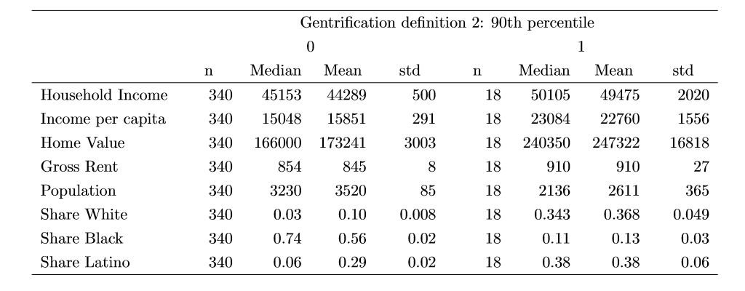
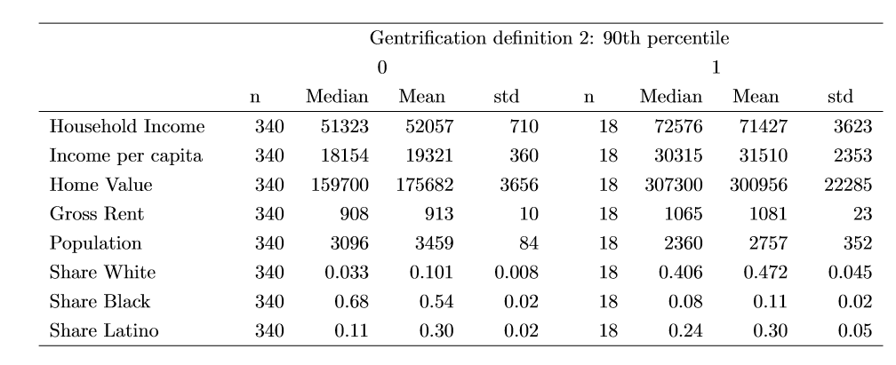
Summary Statistics – Def. #2 (90th per)
Comments:
18 tracts meet definition #2 with higher changes in white population. Gentrified tracts are initially less populated, with higher share of latinos, higher income and home values but median and mean rents are similar.

Slide 19
MAP of tracts increase median income under defition #1 at the 75th perc (use colors)

Slide 20
MAP of tracts increase home values under defition #1 at the 75th perc (use colors)

Slide 21
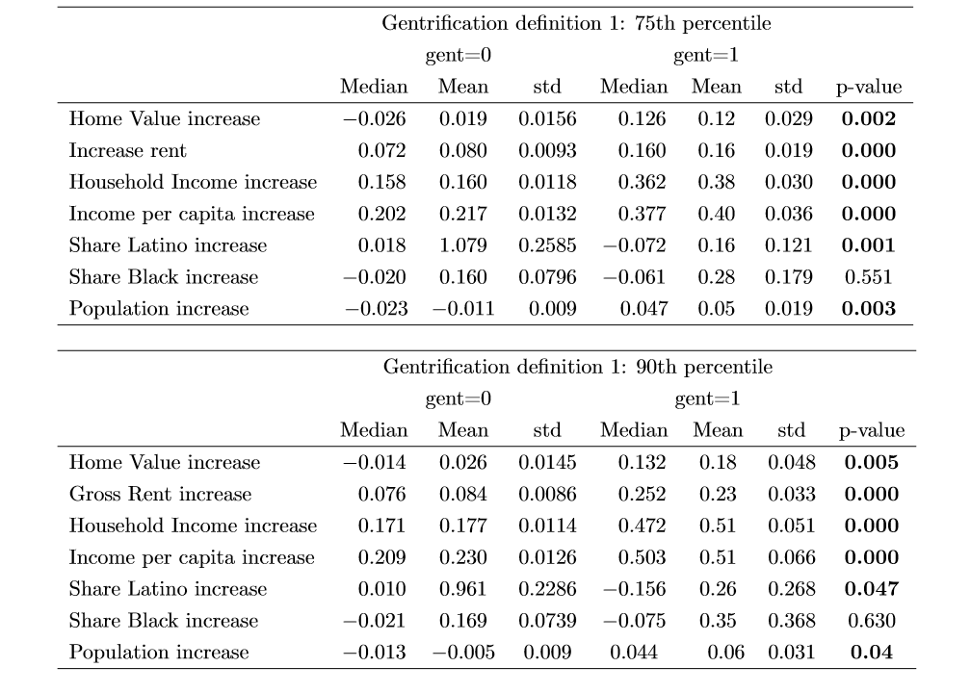
Summary Statistics – Changes – Def. #1
Comments: Home values, rents, income, and population increase significantly in gentrified tracts. Gentrification locates significantly more in Latino tracts.
Home values increase between 12% and 18%, and rents increase between 16 and 23% in gentrified tracts

Slide 22
Bullet comments on summary statistics under def #1
Comments: Home values, rents, income, and population increase significantly in gentrified tracts. Gentrification locates significantly more in Latino tracts.
Home values increase between 12% and 18%, and rents increase between 16 and 23% in gentrified tracts

Slide 23
MAP of tracts increase median income under defition #2 at the 75th perc (use colors)

Slide 24
MAP of tracts increase home values under defition #2 at the 75th perc (use colors)

Slide 25
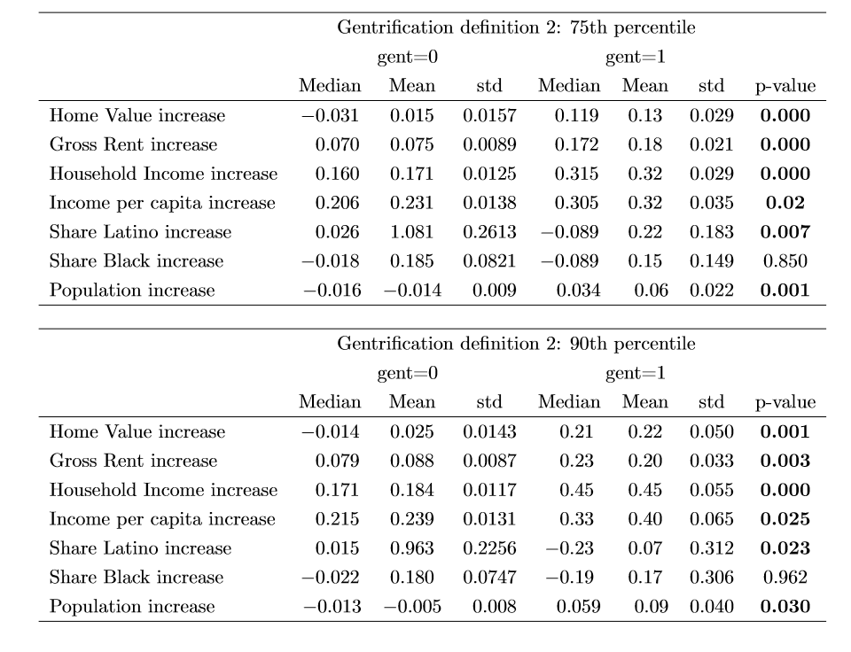
Summary Statistics – Changes – Def. #2

Slide 26
Bullet comments on summary statistics under def #2
Comments: Home values, rents, income, and population increase significantly in gentrified tracts. Gentrification locates significantly more in Latino tracts.
Home values increase on average between 13% and 22%, and rents increase between 18 and 20% in gentrified tracts

Slide 27
Recommendations for legislation

Slide 28
For More Information
Ralph Martire
Executive Director, Center for Tax and Budget Accountability and
Arthur Rubloff Endowed Professor of Public Policy
at Roosevelt University
(312) 332-1049
rmartire@ctbaonline.org
Drazzel Feliu
Research Director, Center for Tax and Budget Accountability
(312) 332-2151
dfeliu@ctbaonline.org
.
CTBA's principal goal is to ensure major policy systems work to promote social and economic justice. You can help strengthen our efforts by making a tax-deductible donation at www.ctbaonline.org/donate

